Slide 1
SMART ANTENNA SYSTEMS
(an overview)
EE 525 Antenna Engineering

Slide 2
Smart Antenna Array:
antenna array with a digital signal processing capability to transmit and receive in an adaptive and spatially sensitive manner.
“Smart” >> digital signal processing facility

Slide 3
USAGE
Applications to:
cellular and wireless networks
radar
electronic warfare (EWF) as a countermeasure to electronic jamming
satellite systems

Slide 4
WHY SMART ANTENNA ARRAYS?
      Higher Capacity
      Higher Coverage
      Higher bit rate
      Improved link quality
      Spectral efficiency
      Mobility

Slide 5
Elements of a Smart Antenna
number of radiating elements
a combining/dividing network
control unit

Slide 6
Aim :
to maximize the antenna gain in the desired direction
to minimize the gain in directions of interferers

Slide 7
Types of Smart Antennas
Switched lobe (SL):
( also called “switched beam” )
simplest technique
comprises only a basic switching function between separate directive antennas or predefined beams of an array

Slide 8
Types of Smart Antennas - cont’d
Dynamically phased array (PA):
continuous tracking can be achieved by including a direction of arrival (DoA) algorithm for the signal received from the user
can be viewed as a generalization of the switched lobe concept

Slide 9
Conventional Antennas & Arrays
Top View
Top View
Antenna
Antenna Array
Omnidirectional
Sectorized

Slide 10
WHY SMART ANTENNA ARRAYS ARE
SUPERIOR TO CONVENTIONAL ANTENNAS
Desired User
Active Beam
Antenna Array
Interfering User
Antenna Array
Switched Beam System
Adaptive Array

Slide 11
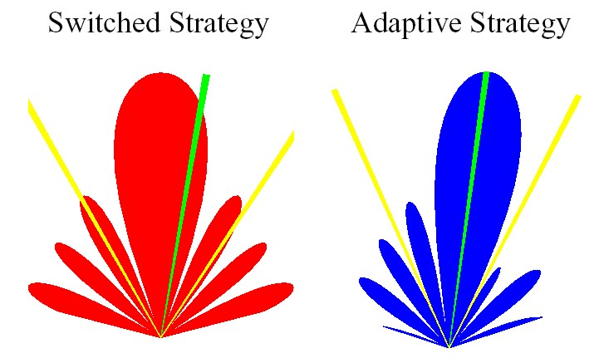
Interference Rejection Comparison
Desired Signals
Co-channel Interfering Signals

Slide 12
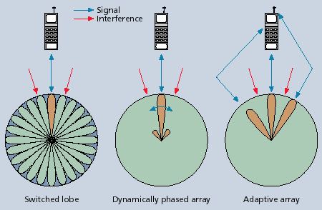
TYPES (summary)

Slide 13
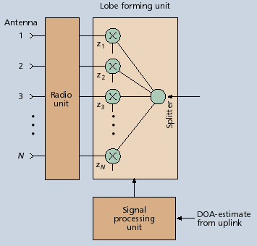
Transmission Part

Slide 14
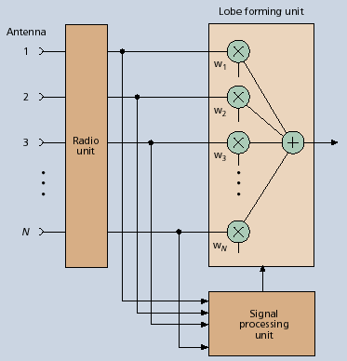
Reception Part

Slide 15
Smart Antennas for Base Stations
the idea of smart antennas is to use base station antenna patterns that are not fixed, but adapt to the current radio conditions
can be visualized as the antenna directing a beam toward the communication partner only

Slide 16
SMDA
(Space Division Multiple Access)
more than one user can be allocated to the same physical communications channel simultaneously in the same cell
separated by angle only
in a TDMA system, two users will be allocated to the same time slot and carrier frequency at the same time and in the same cell

Slide 17
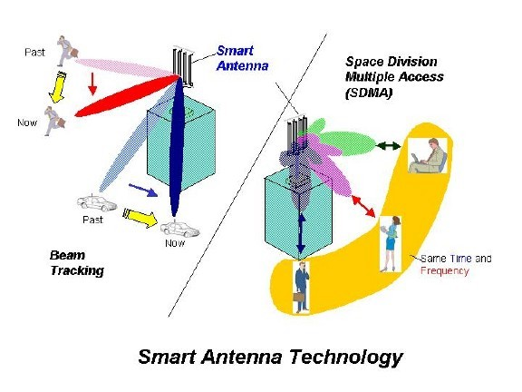
SDMA (Space Division Multiple Access)

Slide 18
Comparison of Switched Beam Antenna Adaptive Arrays
Criteria | Switched Beam | Adaptive Array
Integration | Easy to implement Low cost | Transceiver complexity High cost Less hardware redundancy
Range/ Coverage | More coverage compared to conventional systems Less coverage compared to adaptive array | More coverage compared to switched beam system
Interference Rejection | Difficulty in distinguishing between desired signal and interferer Does not react to the movement of interferers. | Focusing is narrower Capable of nulling interfering signals

Slide 19
REFERENCES
“Smart Antenna Systems Tutorial”, The International Engineering Consortium, http://www.iec.org/online/tutorials/smart_ant/
Lehne, P.H. and Pettersen M., “An Overview of Smart Antenna Technology for Mobile Communications Systems”, IEE Communications Surveys, Fourth Quarter 1999, vol. 2, no.4, http://www.comsoc.org/livepubs/surveys/public/4q99issue/pdf/Lehne.pdf
Schüttengruber, W., Molisch A.F. and Bonek E., “Smart Antennas for Mobile Communications Tutorial”, http://www.nt.tuwien.ac.at/mobile/research/smart_antennas_tutorial/index.en.html
“Smart Antennas Tutorial,” http://viterbi.ece.iisc.ernet.in/prem/SmartAnt/
“Smart Antennas – A Non-technical Introduction”, SYMENA Software & Consulting GmbH, http://www.symena.com/Smart Antennas - A Nontechnical Introduction - SYMENA.pdf

